Slide 1

HEALTH INSURANCE MARKETPLACE
GROUP : C
Kulwinder Kaur
Jalashri Raval
Moath Aldarrab

Slide 2
Table Of Contents :
Abstract
Specification Of Dataset
Introduction
Tools Used For The Analysis
Implementation
Visualization
Conclusion
Dataset and Github URL

Slide 3
Abstract :
Reference :
https://www.cms.gov/cciio/resources/data-resources/marketplace-puf.html
Size : 701 MB.
- Tasks: Exploring plan rates and benefits vary across states, how do plan rates vary by age, how do plans vary across insurance network providers. How do dental plan rates vary for a state.

Slide 4
Specification Of Dataset :
Health Insurance Marketplace data is provided by Centers For Medicare & Medicaid services and is available on www.cms.gov
File Size : 701 MB/ File
File Format : CSV ( Comma Separated Values )
Cluster specification:
Number of nodes in cluster : 2
Management node : RAM – 48GB
Data node : RAM – 24GB

Slide 5
Introduction :
CMS (center For Medicare & Medicaid Services) and CCIIO (Consumer Information & Insurance Oversight)are committed to increase transparency in Health Insurance marketplace.
The Centers for Medicare & Medicaid Services, CMS, is part of the Department of Health and Human Services (HHS)
Services included,
- Benefits
- Copayments
- Premiums
- Geographic Coverage

Slide 6
PUFs : ( 2014 ⁻ 2017 )
For the researchers and stakeholders get easy access of marketplace data.
For consumers, when shopping for a marketplace Qualified Health Plans (QHP).
Only includes the data from state partnership marketplaces & state based marketplace that rely on the federal information technology .

Slide 7
Total files: 25
2017 Data Dictionaries | 2016 Data Dictionaries | 2014 and 2015 Data Dictionaries
Benefits and Cost Sharing Data Dictionary | Benefits and Cost Sharing Data Dictionary | Benefits and Cost Sharing Data Dictionary
Rate Data Dictionary | Rate Data Dictionary | Rate Data Dictionary
Plan Attributes Data Dictionary | Plan Attributes Data Dictionary | Plan Attributes Data Dictionary
Business Rules Data Dictionary | Business Rules Data Dictionary | Business Rules Data Dictionary
Service Area Data Dictionary | Service Area Data Dictionary | Service Area Data Dictionary
Network Data Dictionary | Network Data Dictionary | Network Data Dictionary
Plan ID Crosswalk Data Dictionary | Plan ID Crosswalk Data Dictionary | Plan ID Crosswalk Data Dictionary
Machine - readable Data Dictionary | Machine - readable Data Dictionary | N/A
Transparency in Coverage Data Dictionary | N/A | N/A
Quality Data Dictionary | N/A | N/A
Files Used For Analysis: 6
2014 Data Dictionaries | 2015 Data Dictionaries | 2016 Data Dictionaries
Rate Data Dictionary | Rate Data Dictionary | Rate Data Dictionary
Network Data Dictionary | Network Data Dictionary | Network Data Dictionary

Slide 8




Tools Used For The Analysis:
Hive
Pig
Tableau
Excel

Slide 9
Implementation

Slide 10
Average Rate : 2014
Year : 2014
Age Group : 0 – 20 years
Alaska has highest average rate $249.94 and Wisconsin has the second highest $174.74
Missouri has the lowest average rate $65.84 and Arkansas has the second lowest $71.76.

Slide 11
Average Rate : 2014
Year : 2014
Age Group : 65 and above years
Alaska has highest average rate $1134.68 and Wisconsin has the second highest $824.38 .
Nebraska has the lowest average rate $299.45 and Missouri has the second lowest $328.11.

Slide 12
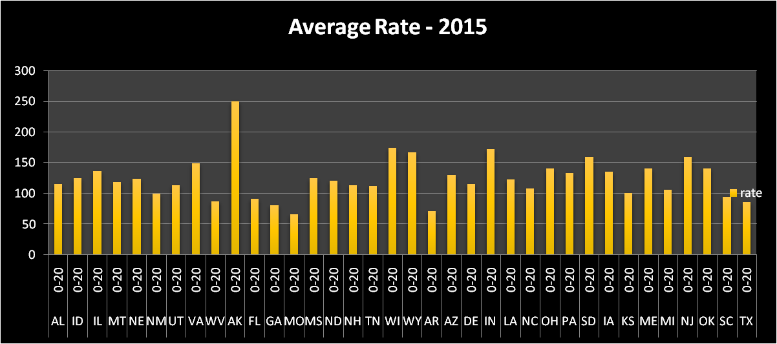
Average Rate : 2015
Year : 2015
Age Group : 0 – 20 years
Alaska has highest average rate $249.94 and Wisconsin has the second highest $174.74
Missouri has the lowest average rate $65.84 and Arkansas has the second lowest $71.76.

Slide 13
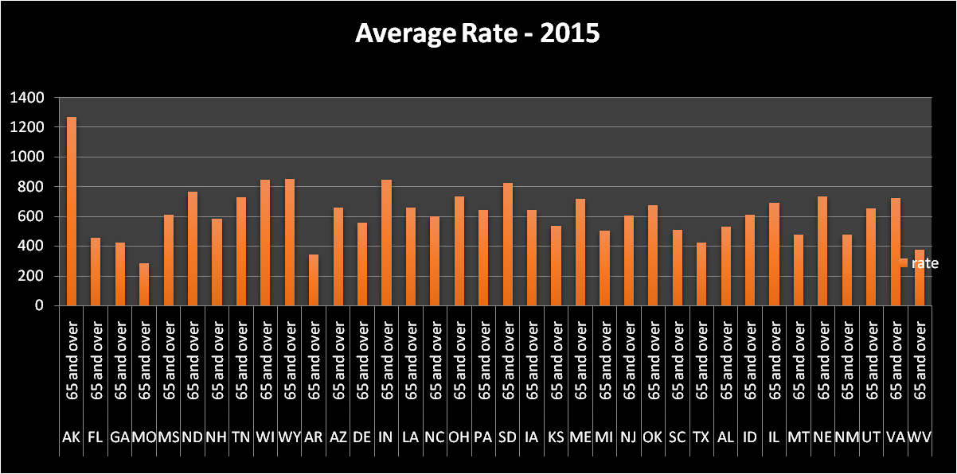
Average Rate : 2015
Year : 2015
Age Group : 65 and above years
Alaska has highest average rate $1271.11 and Wyoming has the second highest $852 .
Missouri has the lowest average rate $281.18 and Arkansas has the second lowest $343.69.

Slide 14
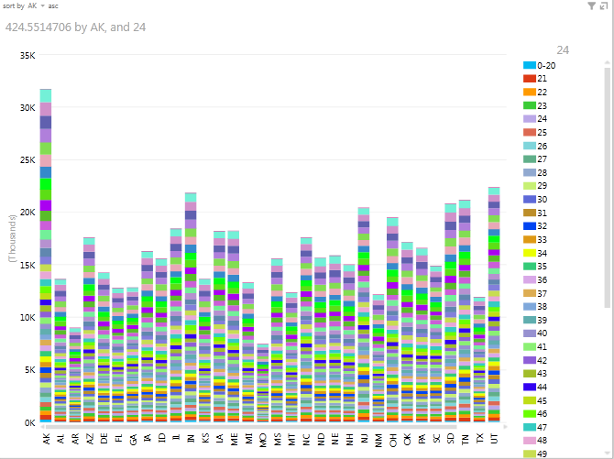
Average rate of different states for different ages

Slide 15
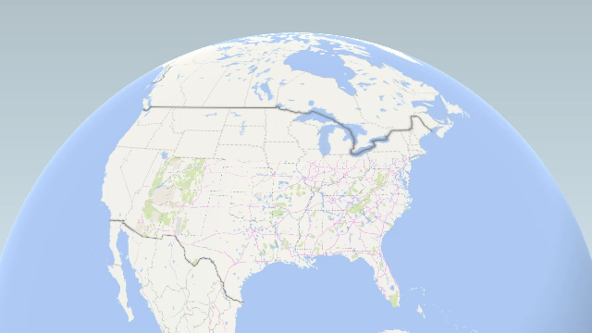
3D View

Slide 16
Change in rates:
statecode | age | 2014 | 2015 | DIFFERENCE
AK | 0-20 | 249.9422222 | 249.9422222 | 2.27374E-13
WI | 0-20 | 174.7432248 | 174.7432248 | 9.9476E-13
IN | 0-20 | 172.6394596 | 172.6394596 | 8.52651E-13
WY | 0-20 | 167.2012579 | 167.2012579 | 0
SD | 0-20 | 160.3082707 | 160.3082707 | 7.38964E-13
NJ | 0-20 | 159.3453427 | 159.3453427 | 6.25278E-13
VA | 0-20 | 148.84705 | 148.84705 | 0
OH | 0-20 | 141.1174657 | 141.1174657 | 0
OK | 0-20 | 141.0680702 | 141.0680702 | 5.96856E-13
ME | 0-20 | 140.7435065 | 140.7435065 | 4.83169E-13
IL | 0-20 | 136.9893617 | 136.9893617 | 6.53699E-13
IA | 0-20 | 135.1521623 | 135.1521623 | 0
PA | 0-20 | 133.5338693 | 133.5338693 | 6.53699E-13
AZ | 0-20 | 130.8679064 | 130.8679064 | 0
ID | 0-20 | 125.5863214 | 125.5863214 | 0
MS | 0-20 | 125.4247788 | 125.4247788 | 9.37916E-13
NE | 0-20 | 124.0103093 | 124.0103093 | 5.25802E-13
LA | 0-20 | 123.1422764 | 123.1422764 | 2.27374E-13
ND | 0-20 | 120.48 | 120.48 | 0
MT | 0-20 | 118.5336195 | 118.5336195 | 2.41585E-13

Slide 17
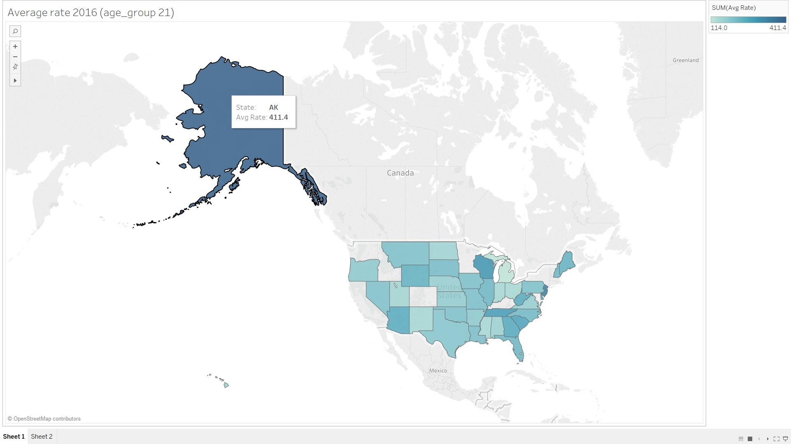
Average Rate - 2016
Age Group : 21 years

Slide 18
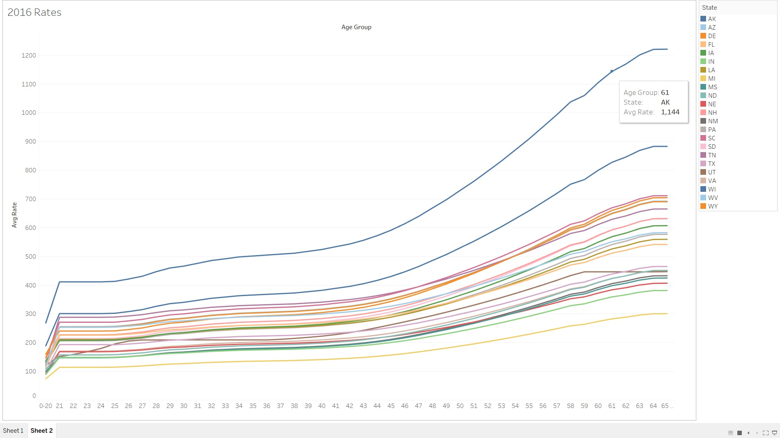
Average Rate - 2016

Slide 19
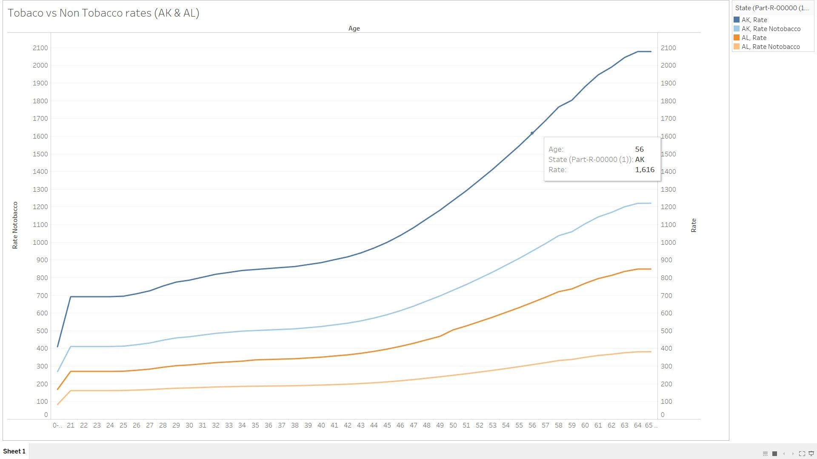
Tobacco v/s Non-tobacco Rates :

Slide 20
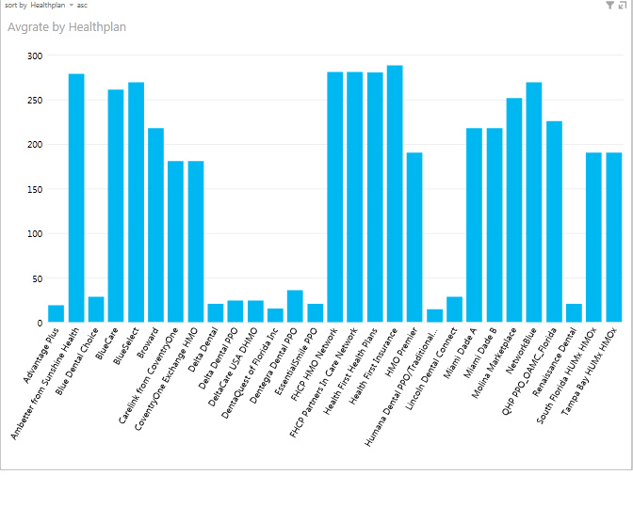
Networks’ Average Rate:
Year : 2014
State : Florida
Age : 25 years

Slide 21
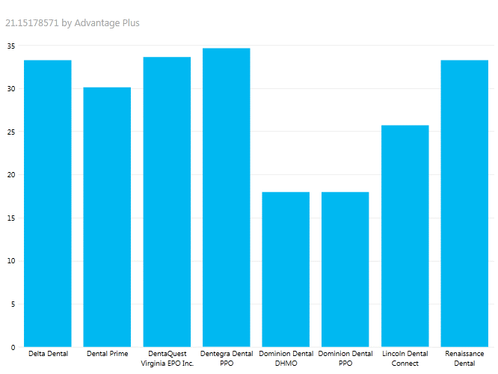
Dental Plans Only :
Year : 2014
State : Virginia
Age : 25 years

Slide 22
Problems we have faced:
1- Importing the .csv to hive and pig
At the beginning of the project, we struggled calling different methods to deal with csv format especially in hive
2- Data entry was not clean in the rate column.
example: 999999 or 0 instead of leaving it as an empty entry.

Slide 23
Github :
https://github.com/kkaur7/healthinsurancedata

Slide 24
Conclusion:
Analysis of average rates of a particular age group for different years, like
0-20 age(2014) for AK 249.94
Comparison of the average rates for different years.
249.9422222-249.9422222 = 2.27374E-13
Analysis of high cost and low cost of dental plans provided in a state by network providers
Dentegra dental ppo (highest rate) in Virginia and
Dominion dental DHMO has lowest rate in Virginia
Analysis of tobacco rates and non-tobacco rates of a particular age group in different states shows that using tobacco increase the cost by 70%

Slide 25
Thank you
Questions...

